Slide 1
Project Presentation: Using Deep Reinforcement Learning for scheduling gasoline blending and distribution (SGBD)
Name: Samarth Bhatia
Supervisor: Prof. Hariprasad Kodamana

Slide 2
Overview
Work completed
Thoroughly read the 2 papers
Learn about basics of RL
Learn about Deep RL (DRL) and it’s widely used algorithms
Implement some examples of DRL
Develop an RL environment for my task (in progress)

Slide 3
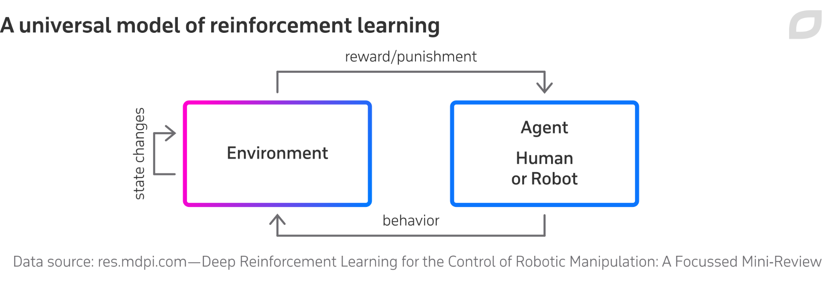
Introduction: RL
Reinforcement Learning deals with teaching ‘agents’ how to take actions given a certain environment. These actions bring about change in the environments with the goal of receiving a reward.
When the agent is a neural network, the field is said to be Deep RL.
These environments need to be modelled according to whatever process we are trying to learn/simulate. Modelling them precisely and correctly is essential, and takes up the most time.

Slide 4
Introduction to openai:gym (python)
In RL, we need to model new environments for new tasks.
Unorganised env
confusing function calls.
gym by OpenAI standardizes environments.
Makes environments structured
Makes interaction with env intuitive
Makes benchmarking of agents possible

Slide 5
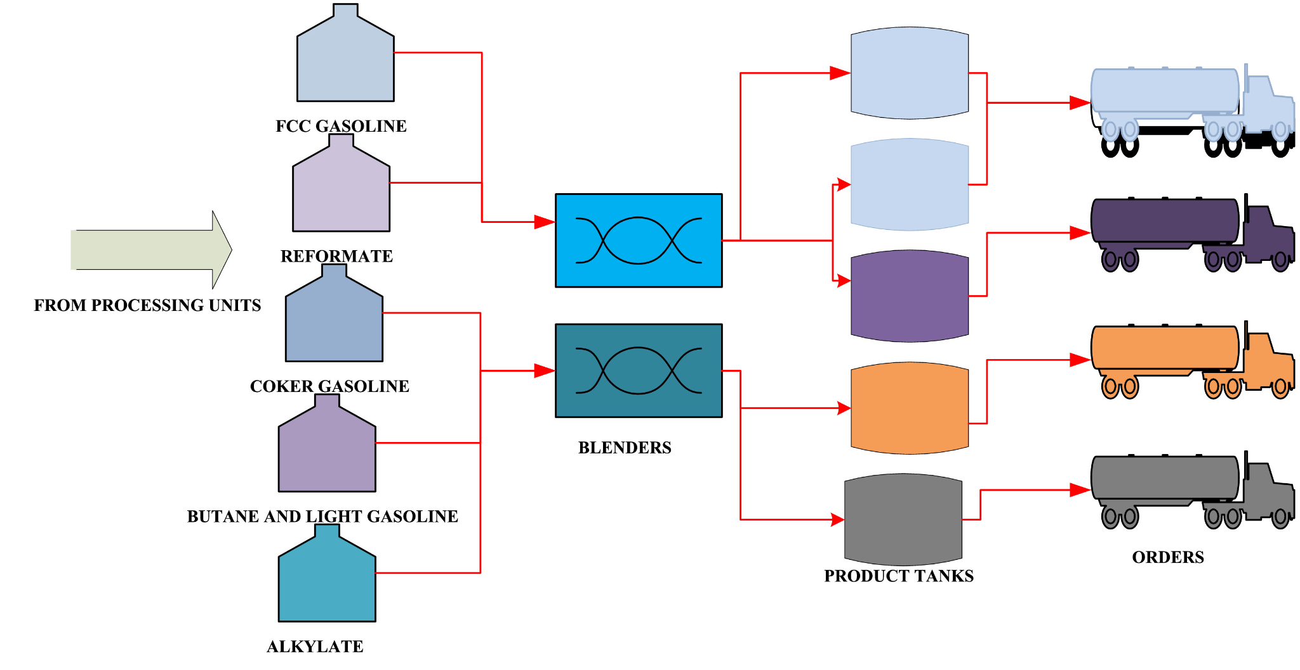
Summary (Paper 1): “Scheduling of gasoline blending and distribution using graphical genetic algorithm”
Environment
This paper models the example SGBD environment shown in the figure accounting for:
Inventory levels in tanks
Blending rates
Flow rates in b/w components
Tardiness in orders
Changeovers in tanks
Costs of all these
They solve this using a graphical genetic algorithm (GGA) and have better results than a industry standard mixed integer nonlinear programming (MINLP) model.

Slide 6
Summary (Paper 2): “A deep reinforcement learning approach for chemical production scheduling”
Summary
In this paper, the author trains a Advantage Actor-Critic (A2C) agent.
Also trains mixed-integer linear programming (MILP) models to compare results
DRL outperforms mathematical models by significant amount
Problems
The env in which training is done is not defined in detail.
The code for the paper is not open source, just a shrunk down, undocumented version.
The author does not use gym or any other widely used toolkit to make the env, making it hard to interpret.

Slide 7
Work completed
Learning Tasks
I learnt RL and DRL from various sources including UC Berkeley’s DRL course (CS285), Udacity’s DRL course and other lectures/tutorials.
I learnt RL concepts like
the Bellman eqn.
Action-Value methods (Q-Networks and DQNs) - suited for discrete envs
Policy-Gradient methods (REINFORCE, PPO) - suited for continuous envs
Actor-Critic methods (A2c, A3C) - combines best of both
Separately I also learned how to implement DRL models like DQNs,the REINFORCE algorithm with a NN and a sample of A2c)

Slide 8
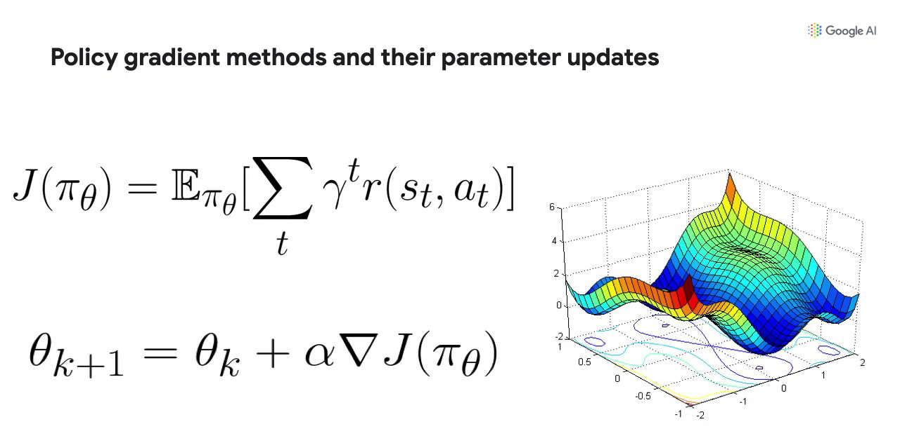
Difference b/w
Action-Value methods Basically looking up the Q-table for the action with highest Q-value for the given discrete state.
Policy-Gradient methods These rely on updating policy parameters using gradient descent according to the rewards received.
Q-table | Action 1 | _ _ _ _ _ _ _ _ |  | Action n
State 1 | 0.12 | _ _ _ _ _ _ _ _ |  | 1.96
_ _ _ _ | _ _ _ _ _ _ _ _ _ _ _ _ _ _ _ _ _ _ _ _ | _ _ _ _ _ _ _ _ _ _ _ _ _ _ _ _ _ _ _ _ _ _ _ _ _ _ _ _ _ _ _ _ _ _ _ _ _ _ _ _ |  | _ _ _ _ _ _ _ _ _ _ _ _ _ _ _ _ _ _ _ _
State n | 0.34 | _ _ _ _ _ _ _ _ |  | -0.2

Slide 9
Actor-Critic Methods
Actor Network:
decides action to be taken
Critic Network:
informs actor how good the action was
how it should adjust
The learning of the actor is based on policy gradient approach. In comparison, critic evaluates the action by computing a value function.

Slide 10
Environment for SGBD
I am making an environment for the problem of scheduling gasoline blending and distribution (SGBD) based on the variables given in Paper 1. The work is available on github: Plutonium-239/deeprl-in-sgbd. (The repository also includes the sample implementations I have done in the process of learning RL)
I have implemented the observation spaces (the possible “range” of values for all the variables) along with the variables themselves and their relations /constraints.

Slide 11
Future Work
Environment
Implementing an action space to interact with the env
Implementing the step method to take an action and update the environment
Finishing up and packaging (Making it open source and easily installable)
RL Agent
Implement a A2c/A3c (basically an actor-critic method) to learn the env (using PyTorch)
Some baseline models to gauge performance
Using packages like stable-baselines to check differences in performance, if any.

Slide 12
Thank you

